Slide 1
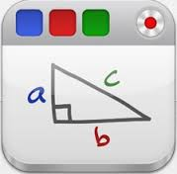
App Smashing
Beth Dabney
Instructional Technology Coach
Anderson School District 2
January 16, 2015

Slide 2
App Smashing Defined:
The process of using multiple apps in conjunction with one another to complete a final task or project.
http://edtechteacher.org/app-smashing-from-greg/

Slide 3
Why App Smash?
It demands creative thinking
It demands more from the technology (value for money)
It turns the issue of not having a ‘wonder app’ into a positive
It removes any restrictions to take a topic as far as it can be taken
It often results in more engaging learning products
It’s a fun challenge for ‘digital natives’
http://ipad4schools.org/2014/04/19/why-app-smash/

Slide 4
Most important app:
Camera Roll

Slide 5
Super Important Button:
This is how you save to the iPad!

Slide 6
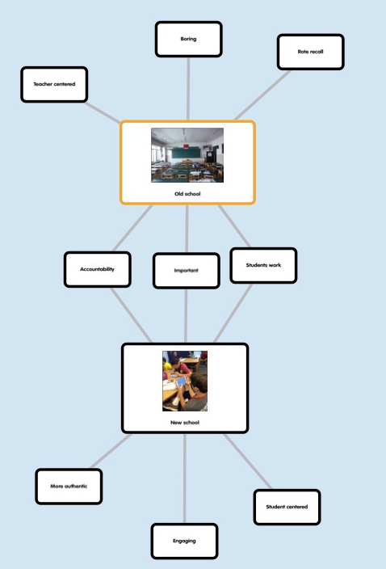
Brainstorming/Organizing
Popplet Lite is used as a mind-map, It helps students think and learn visually. Students can capture facts, thoughts, and images and learn to create relationships between them. Can be saved to Camera Roll. (Free)
Create, edit, and collaborate in real time with others with the free Google Docs app. Students never need to worry about losing work -- everything is automatically saved as they type. (Free)

Slide 7
Presentations
Students can create and edit stunning presentations on the iPad with the Prezi App. They can share their presentations easily. Students can work also work collaboratively. (Free)
Evernote is a suite of software and services, designed for note taking and archiving. A "note" can be a piece of formatted text, a full webpage or webpage excerpt, a photograph, a voice memo, or a handwritten "ink" note. Notes can also have file attachments. (Free)
Haiku Deck makes it a snap to create beautiful presentations that will wow your audience – whether you’re pitching an idea, teaching a lesson, telling a story, or igniting a movement. (Free)

Slide 8
White-boarding
Educreations is a unique interactive whiteboard and screencasting tool that's simple, powerful, and fun to use. Annotate, animate, and narrate nearly any type of content as you explain any concept. Teachers can create short instructional videos and share them instantly with students, or ask students to show what they know and help friends learn something new.
(Free-paid to export to camera roll)
Combining screencasting, desktop control, and an interactive whiteboard in one app, create a lesson or presentation, insert images, save and edit your project and record a screencast video you can easily save or share. Doceri does it all!
(Free)
Explain Everything is an easy-to-use design, screencasting, and interactive whiteboard tool that lets you annotate, animate, narrate, import, and export almost anything to and from almost anywhere.
($2.99)

Slide 9
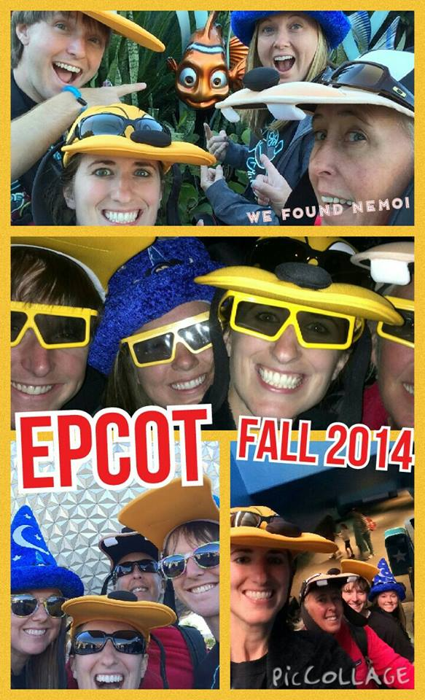
Pics and Text
See something that sparks an idea? Use Skitch to snap it, mark it up with simple tools, and send it on in an instant. (Free)
Book Creator is a great app for combining images with text and links to other content. Books can be produced as a team project on multiple iPads. ($4.99)
Students can import photos from the photo library or do a web image search. They use simple touch gestures to rotate, resize, and flick to delete. Easily clip photos by outlining the area wanted with finger. Export final product to camera roll. (Free)

Slide 10
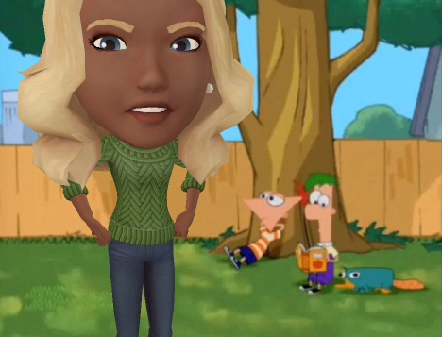
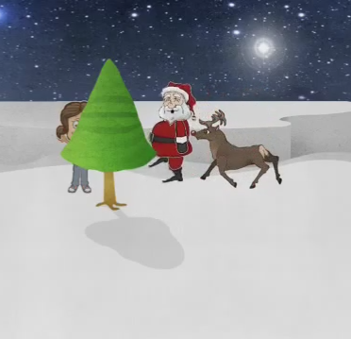
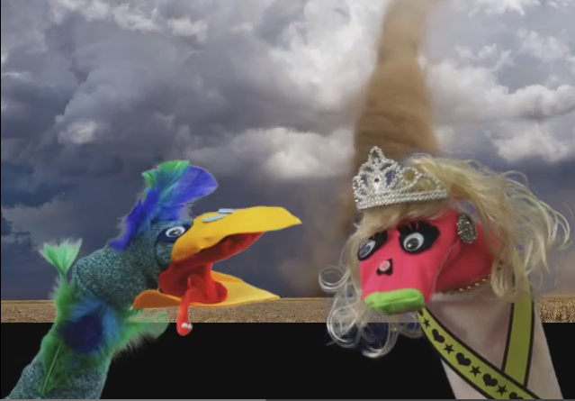
Videos
Animoto allows students to easily make videos with photos an video clips from the camera roll. Students will select a sleek video style, add a song, some pictures, and text, then they’re done! Completed video can be shared via link and to camera roll. (Free)
Tellagami lets students create and share quick animated videos called a Gamis. They can be up to 90 seconds long. Students customize a character and choose their background then record or type their message. Paid version can be saved to camera roll. ($4.99)
Puppet Pals 2 allows students to create animated cartoons. Children unlock creativity with this easy to use (but hard to put down) interactive puppet show! Even young children can create high quality cartoons from their imaginations. Backgrounds and characters can be customized. ($9.99)
With Sock Puppets, students create their own lip-synched videos and share them via the camera roll (paid app). Add Puppets, props, scenery, and backgrounds and start creating. Hit the record button and the puppets automatically lip-synch to your voice. ($3.99)

Slide 11
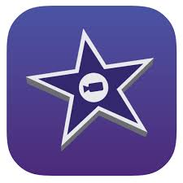
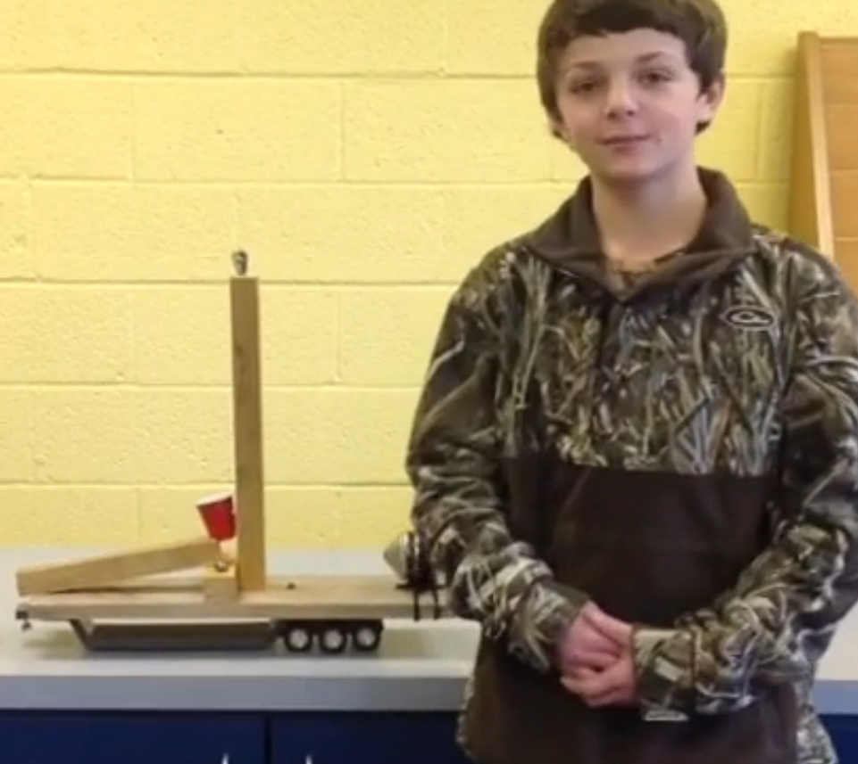
Bring it all together!
The iMovie app (free on most iPads-$4.99 if not) allows students to browse the camera roll and easily create impressive movies. Other products, images and video, can be imported and added to the video project. Videos can be exported and shared.

Slide 12
Publish!
Don’t keep all of their hard work on the iPad!
Dropbox allows you to get products off of and on to the iPad. Easy to upload and share.
ThinkLink can make student images come alive! You can add private video, notes, or even music from YouTube. Use ThingLink to instantly add video and text to images.
Google Drive allows you to get products off the iPad. Easy to upload and share.
Students can use Prezi to publish their work. Videos from YouTube and images from the camera roll can be added to presentations.
AudioBoom allows students to record up to 10 minutes of audio. Link is created. QR code can easily be generated.
Weebly website generator can be used by students to keep a portfolio of their work. Students can add text, images, and video to their websites.
AirDrop allows iPad users to easily share files between two iPads.

Slide 13
Other apps to consider:
Green Screen by Do Ink makes it easy to create incredible green screen videos and images right on the iPad. This app emphasizes ease-of-use and simplicity while still enabling fantastic results. With Green Screen by Do Ink, students can tell a story, explain an idea, and express themselves in truly creative and unique ways. ($2.99)
Aurasma is an augmented reality app that brings tagged images, objects and even physical locations to life with interactive digital content, such as video, animations, and 3D. Students can build Auras using their own photos and videos, or alternatively, select from thousands of digital animations available on the platform. (Free)

Slide 14
Start Slow
You don’t want to introduce all apps to students at one time! Try to scaffold them, using different apps for different projects throughout the year. As you complete more and more projects, give students choice as to which apps they can use.

Slide 15
How might you use this in your area?
Media – Researching video
ROTC – Recruitment video
Music - Garage Band to make music – use as background music to video
Art – digital book with art work
Business/Keyboarding – Web tutorial on how to use a program like Microsoft Word
Reading Coaches – Retell story from different perspective/book reviews
PE – PSA about eating healthy/exercise
Guidance – PSA on bullying/being a good person
Agriculture –
Home Arts –
Foreign Language – digital story telling in another language

Slide 16
Questions? Comments?
Are you familiar with any apps not listed that would work for an “app smash” project?

Slide 17
Resources
www.edudemic.com/app-smashing-digital-storytelling-ipad/
edtechteacher.org/app-smashing-from-greg/
edtechteacher.org/unleashing-creativity-greg-kulowiec-app-smashing-from-beth-Holland
ipad4schools.org/2014/04/19/why-app-smash/
www.itunes.apple.com/
kulowiectech.blogspot.com/2013/11/app-smashing-app-pack-x-thinglink.html

